Slide 1
Variational Inference in TensorFlow
Danijar Hafner · Stanford CS 20 · 2018-02-16 University College London, Google Brain

Slide 2
Outline
Variational Inference
Tensorflow Distributions
VAE in TensorFlow

Slide 3
Variational Inference

Slide 4
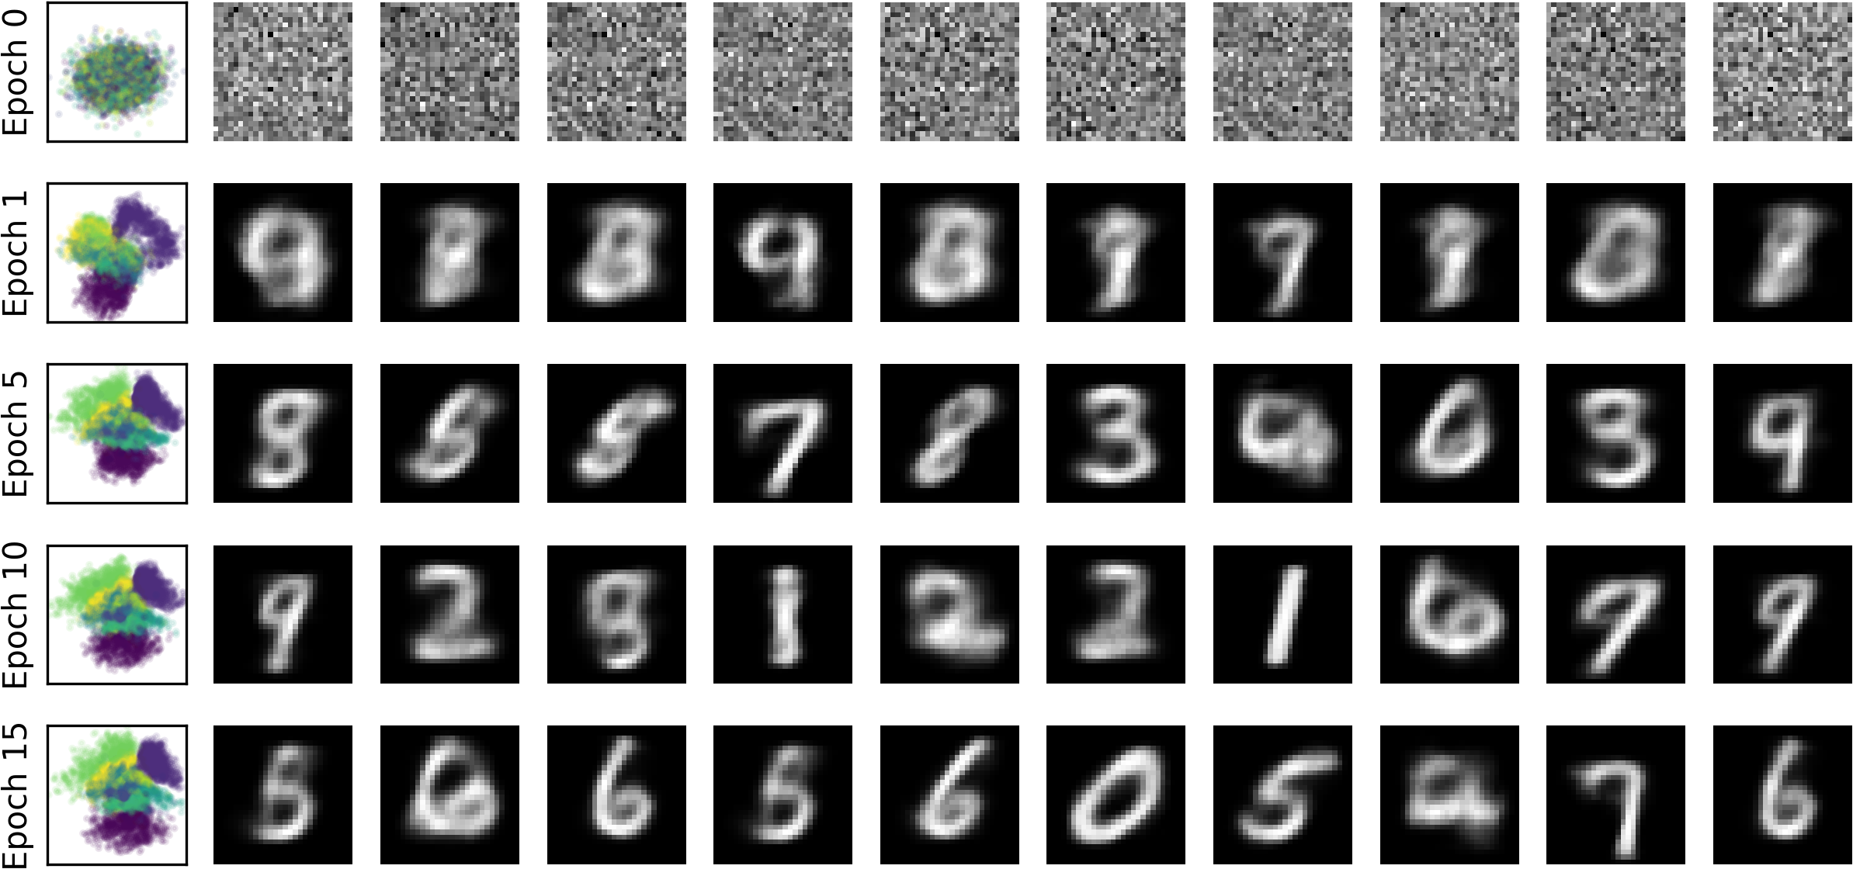
Learning unknown variables
Images consist of millions of pixels, but there is likely a more compact representation of the content (objects, positions, etc)
Finding the mapping to this representation allows us to find semantically similar images and even to generate new images
We call the compact representation z and its corresponding pixels x, and this is the same structure for every of our N images
N
z
x

Slide 5
Learning unknown variables
Assume model where data x was generated from latent variables z
We want to find the latent variables that explain our data best
But we cannot directly maximize the data likelihood since it depends on the latent variables and we don't know their values
θ* = argmax P_{θ}(x) = argmax ∫ P_{θ}(x|z)P(z) dz
We define a prior assumption P(z) about how z is distributed
We are interested in the posterior belief P(z|x) that depends on the corresponding data point x
N
z
x

Slide 6
Variational lower bound: Overview
Iteratively optimize approximate posterior Q(z) until Q(z) ≈ P(z|x)
Objective for Q(z) is the variational lower bound
lnP(x) ≥ E_{Q(z)}[lnP(x,z) − lnQ(z)]
= E_{Q(z)}[lnP(x|z) + lnP(z) − lnQ(z)]
= E_{Q(z)}[lnP(x|z)] − D_{KL}[Q(z)||P(z)]
This is a lower bound since the KL is non-negative
Choose Q(z) ϵ 𝒬 that allows differentiable sampling, often Gaussian distribution
KL becomes a regularization terms; computed analytically or sampled
P(z|x)
𝒬
Q(z)

Slide 7
Variational lower bound: Algorithm
Initialize fixed prior on latents P(z), for example zero mean unit variance
Initialize network weights θ and sufficient stats μ and σ of Q(z)
Remember objective lnP(x) ≥ E_{Q(z)}[lnP_{θ}(x|z)] − D_{KL}[Q(z)||P(z)]
Iterate until convergence:
Sample a z ~ Q(z) as z = σε + μ with ε ~ N(0, 1)
Compute data likelihood P_{θ}(x|z) using neural network
Compute KL between Q(z) and P(z) analytically
Perform gradient ascent on objective to optimize θ, μ, σ
P(z|x)
𝒬
Q(z)

Slide 8
Amortized inference: Overview
We could learn sufficient stats of Q(z) for every data point via gradient descent
But need multiple gradient steps for every data point, even during evaluation
Instead, learn the result of this process using an encoder network Q(z|x)
Assume similarity in how latents are inferred for all data points
Backpropagate to optimize encoder weights instead of posterior sufficient statistics
P(z|x)
𝒬
Q(z|x)

Slide 9
Amortized inference: Algorithm
Initialize fixed prior on latents P(z), for example zero mean unit variance
Initialize encoder weights ϕ and decoder weights θ
Remember objective lnP(x) ≥ E_{Q(z)}[lnP_{θ}(x|z)] − D_{KL}[Q_{ϕ}(z|x)||P(z)]
Iterate until convergence:
Select data point x and compute Q_{ϕ}(z|x) using encoder
Sample a z ~ Q(z|x) as z = σε + μ with ε ~ N(0, 1)
Compute data likelihood P_{θ}(x|z) using decoder
Compute KL between Q(z) and P(z) analytically
Perform gradient ascent on objective to optimize θ and ϕ
P(z|x)
𝒬
Q(z|x)

Slide 10
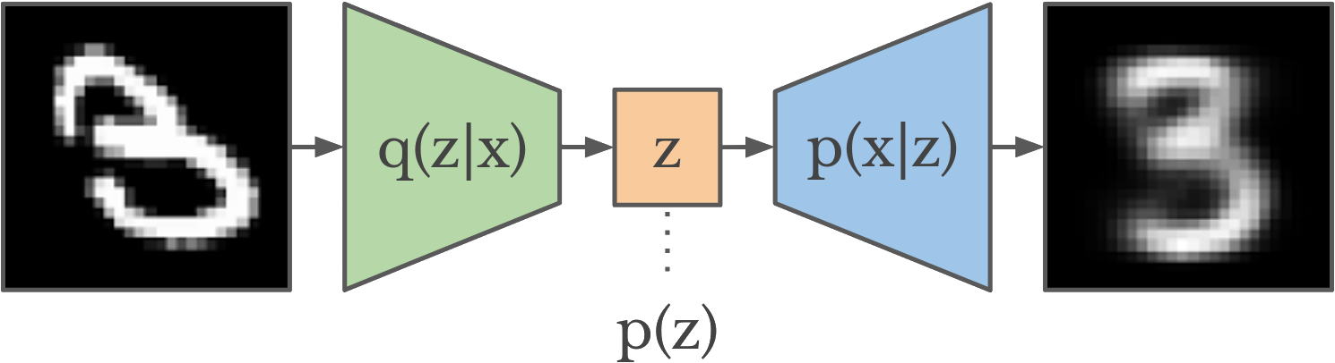
Variational Auto-Encoder
N
z
Encoder for amortized inference Q(z|x)
Decoder for generative model P(x|z)
Variational lower bound objective E_{Q(z|x)}[lnP(x|z)] − D_{KL}[Q(z|x)||P(z)]
Trained end-to-end via gradients by reparameterized sampling
x
Kingma et al. 2014, Rezende et al. 2014

Slide 11
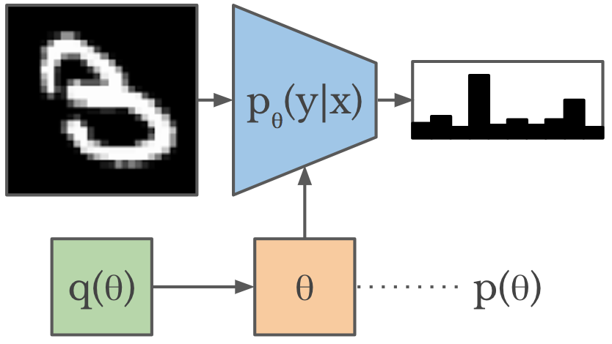
Bayesian Neural Network
N
x
Independent latent Q(θ) is diagonal Gaussian
Conditional generative model P_{θ}(y|x)
Variational lower bound objective E_{Q(θ)}[lnP_{θ}(y|x)] − D_{KL}[Q(θ)||P(θ)]
Divide KL term by the data set size since parameters are shared for whole data set
Trained end-to-end via gradients by reparameterized sampling
θ
y
Blundell et al. 2015

Slide 12
TensorFlow Distributions

Slide 13
TensorFlow Distributions: Overview
Probabilistic programming made easy!
tfd = tf.contrib.distributions

Slide 14
TensorFlow Distributions: Overview
Probabilistic programming made easy!
tfd = tf.contrib.distributions
mean = tf.layers.dense(hidden, 10, None)
stddev = tf.layers.dense(hidden, 10, tf.nn.softplus)
dist = tfd.MultivariateNormalDiag(mean, stddev)

Slide 15
TensorFlow Distributions: Overview
Probabilistic programming made easy!
tfd = tf.contrib.distributions
mean = tf.layers.dense(hidden, 10, None)
stddev = tf.layers.dense(hidden, 10, tf.nn.softplus)
dist = tfd.MultivariateNormalDiag(mean, stddev)
samples = dist.sample()
dist.log_prob(samples)

Slide 16
TensorFlow Distributions: Overview
Probabilistic programming made easy!
tfd = tf.contrib.distributions
mean = tf.layers.dense(hidden, 10, None)
stddev = tf.layers.dense(hidden, 10, tf.nn.softplus)
dist = tfd.MultivariateNormalDiag(mean, stddev)
samples = dist.sample()
dist.log_prob(samples)
other = tfd.MultivariateNormalDiag(
tf.zeros_like(mean), tf.ones_like(stddev))
tfd.kl_divergence(dist, other)

Slide 17
TensorFlow Distributions: Regression example
tfd = tf.contrib.distributions
hidden = tf.layers.dense(inputs, 100, tf.nn.relu)
mean = tf.layers.dense(hidden, 10, None)
dist = tfd.MultivariateNormalDiag(mean, tf.ones_like(mean))

Slide 18
TensorFlow Distributions: Regression example
tfd = tf.contrib.distributions
hidden = tf.layers.dense(inputs, 100, tf.nn.relu)
mean = tf.layers.dense(hidden, 10, None)
dist = tfd.MultivariateNormalDiag(mean, tf.ones_like(mean))
loss = -dist.log_prob(label) # Squared error
optimize = tf.train.AdamOptimizer().minimize(loss)

Slide 19
TensorFlow Distributions: Classification example
tfd = tf.contrib.distributions
hidden = tf.layers.dense(inputs, 100, tf.nn.relu)
logit = tf.layers.dense(hidden, 10, None)
dist = tfd.Categorical(logit)

Slide 20
TensorFlow Distributions: Classification example
tfd = tf.contrib.distributions
hidden = tf.layers.dense(inputs, 100, tf.nn.relu)
logit = tf.layers.dense(hidden, 10, None)
dist = tfd.Categorical(logit)
loss = -dist.log_prob(label) # Cross entropy
optimize = tf.train.AdamOptimizer().minimize(loss)

Slide 21
VAE in TensorFlow

Slide 22
VAE in TensorFlow: Overview
tfd = tf.contrib.distributions
images = tf.placeholder(tf.float32, [None, 28, 28])
prior = make_prior()
posterior = make_encoder(images)
dist = make_decoder(posterior.sample())

Slide 23
VAE in TensorFlow: Overview
tfd = tf.contrib.distributions
images = tf.placeholder(tf.float32, [None, 28, 28])
prior = make_prior()
posterior = make_encoder(images)
dist = make_decoder(posterior.sample())
elbo = dist.log_prob(images) - tfd.kl_divergence(posterior, prior) optimize = tf.train.AdamOptimizer().minimize(-elbo)
samples = make_decoder(prior.sample(10)).mean() # For visualization

Slide 24
VAE in TensorFlow: Prior & encoder
def make_prior(code_size=2):
mean, stddev = tf.zeros([code_size]), tf.ones([code_size])
return tfd.MultivariateNormalDiag(mean, stddev)
def make_encoder(images, code_size=2):
images = tf.layers.flatten(images)
hidden = tf.layers.dense(images, 100, tf.nn.relu)
mean = tf.layers.dense(hidden, code_size)
stddev = tf.layers.dense(hidden, code_size, tf.nn.softplus)
return tfd.MultivariateNormalDiag(mean, stddev)

Slide 25
VAE in TensorFlow: Networks
def make_decoder(code, data_shape=[28, 28]):
hidden = tf.layers.dense(code, 100, tf.nn.relu)
logit = tf.layers.dense(hidden, np.prod(data_shape))
logit = tf.reshape(logit, [-1] + data_shape)
return tfd.Independent(tfd.Bernoulli(logit), len(data_shape))
The tfd.Independent(dist, 2) tells TensorFlow to treat the two innermost dimensions as data dimensions rather than batch dimensions
This means dist.log_prob(images) returns a number per images rather than per pixel
As the name tfd.Independent() says, it's just summing the pixel log probabilities

Slide 26
VAE in TensorFlow: Results

Slide 27
Bonus: BNN in TensorFlow
def define_network(images, num_classes=10):
mean = tf.get_variable('mean', [28 * 28, num_classes])
stddev = tf.get_variable('stddev', [28 * 28, num_classes])
prior = tfd.MultivariateNormalDiag(
tf.zeros_like(mean), tf.ones_like(stddev))
posterior = tfd.MultivariateNormalDiag(mean, tf.nn.softplus(stddev))

Slide 28
Bonus: BNN in TensorFlow
def define_network(images, num_classes=10):
mean = tf.get_variable('mean', [28 * 28, num_classes])
stddev = tf.get_variable('stddev', [28 * 28, num_classes])
prior = tfd.MultivariateNormalDiag(
tf.zeros_like(mean), tf.ones_like(stddev))
posterior = tfd.MultivariateNormalDiag(mean, tf.nn.softplus(stddev))
bias = tf.get_variable('bias', [num_classes]) # Or Bayesian, too
logit = tf.nn.relu(tf.matmul(posterior.sample(), images) + bias)
return tfd.Categorical(logit), posterior, prior

Slide 29
Bonus: BNN in TensorFlow
def define_network(images, num_classes=10):
mean = tf.get_variable('mean', [28 * 28, num_classes])
stddev = tf.get_variable('stddev', [28 * 28, num_classes])
prior = tfd.MultivariateNormalDiag(
tf.zeros_like(mean), tf.ones_like(stddev))
posterior = tfd.MultivariateNormalDiag(mean, tf.nn.softplus(stddev))
bias = tf.get_variable('bias', [num_classes]) # Or Bayesian, too
logit = tf.nn.relu(tf.matmul(posterior.sample(), images) + bias)
return tfd.Categorical(logit), posterior, prior
dist, posterior, prior = define_network(images)
elbo = (tf.reduce_mean(dist.log_prob(label)) -
tf.reduce_mean(tfd.kl_divergence(posterior, prior))

Slide 30
That's all

